Slide 1

Critical Thinking Group 4: Generational Gap

Slide 2

Saber Nada
Makhmudov Azizkhon
Abid Ali
Mahmud
Abrar
Livia
Lendranita
2021380032
2019380141
2019380188
2021380153
2021380033

Slide 3

Why Generation Gap?

Slide 4
Generation Gap definition
A generation gap is the difference of opinions between one generation and another regarding beliefs and values ; often refers to a perceived gap between younger people and their parents and/ or grandparents .

Slide 5
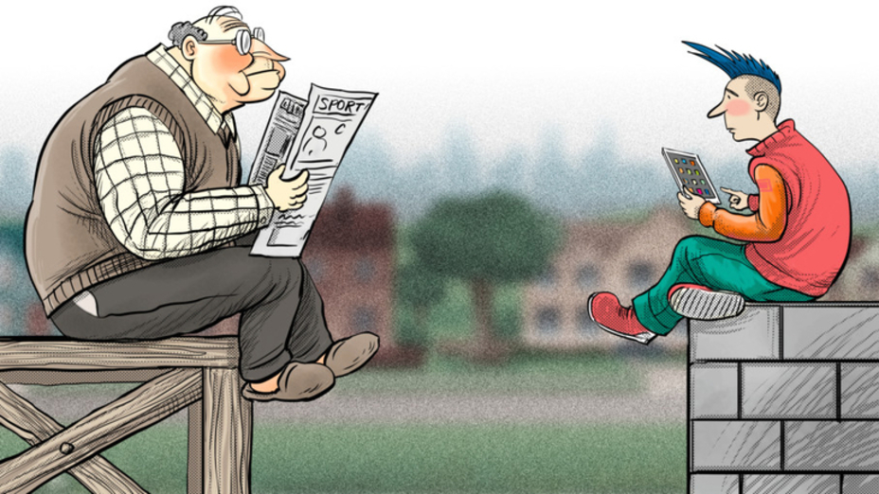
Why Generation Gap?
The gap is one of the most serious issues affecting societies .
The societies that break generations remain backward , unable to grow .
The tragedy of human life is that change is usually the result of unending “clash”; and the generation gap will continue to plague future generations.
This phenomenon touches all the young people problems and their reality

Slide 6
Questions and Answers Currently Available

Slide 7

The solution
Two relevant questions from project
(1) Why is the generation gap ?
(2) How to bridge the gap.
By Critical Thinking I tried to get answer of those questions.

Slide 8
Solution
a) The major issue arrives due to the mental gap in terms of thinking pattern & current trends.
(b) Children believe that they are grown-ups and it is high time for them to be independent
(c) Both parents and their children do not see things from the standpoints of each other.
(d) Lack Of Understanding.
All the family members irrespective of age has to communicate, keep an open mind, listen to and understand each other. Provide unconditional love and learn to compromise.

Slide 9
Why use Critical Thinking?

Slide 10
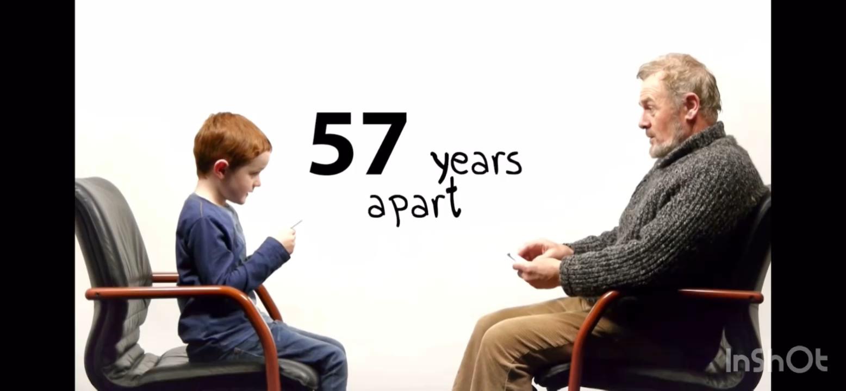

Slide 11
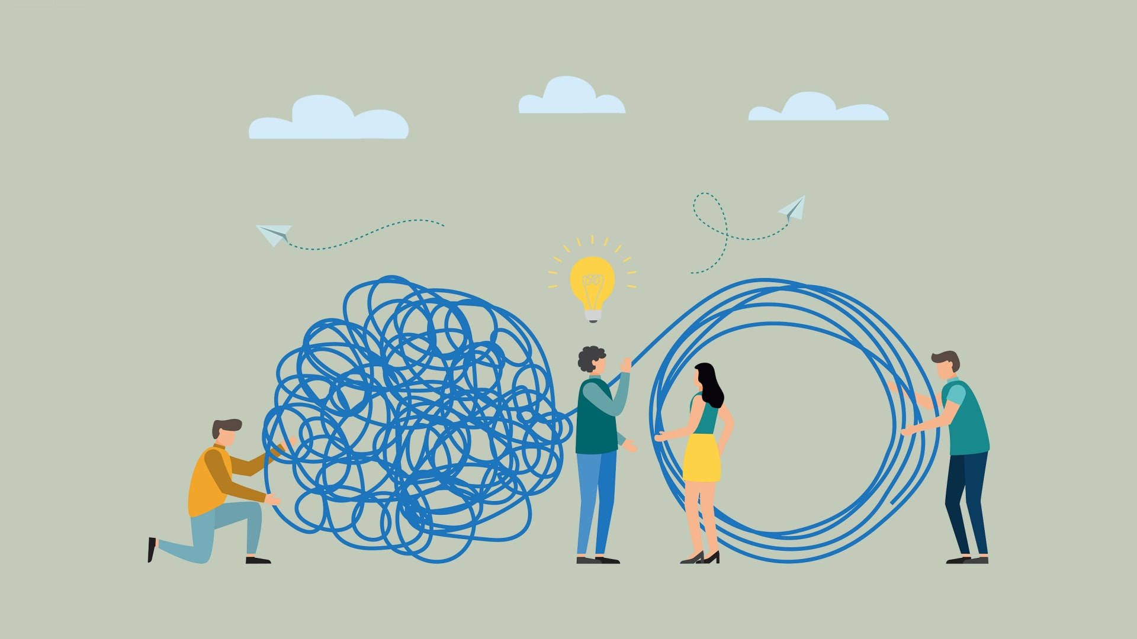
Is this a problem at all?
We can see that the gap is formed by each generation believing it already has all the answers. Each generation thinks that life is operating according to their rules.
Essentially, the problem is that differing experience results in different ideas, and each generation is far too certain that their experience is the correct one

Slide 12

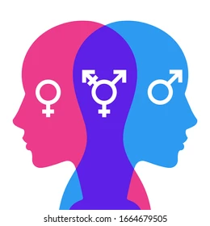




Slide 13

Why use critical thinking skills?
Nowadays people tend to trust a message after it has been repeated many times. It is easier for people to perceive familiar information than to analyze new information. So this may be another reason why people of different ages and era have various contradictions.I believe crittical thinking skills are important in todays world

Slide 14



Slide 15
Why use critical thinking skills?
The society is made up of older gen and younger gen. Society cannot progress without active contribution of both gens. That is why it is crucial that the relation between them should be on the basis of love and honour. They should be mutually satisfied.
I think to solve complex ethical, economic and environmental problems in the future, we need to learn how to work with information and our own thinking now. Critical thinking can be used to come to the right conclusions, make rational and considered decisions about almost everything that concerns us, the same generation gap can be solved with the help of correct and considered thoughts

Slide 16
Solution?
Keep An Open Mind. The way that kids think is different from how parents do.
Communicate. Making the time to communicate with your kids every day is very important.
Listen
Understand.
Unconditional Love.
Compromise.
By understanding each others sentiment & values

Slide 17
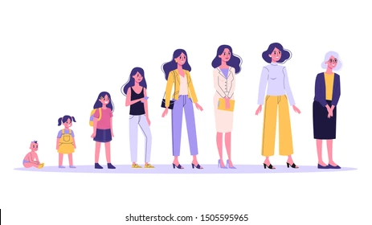
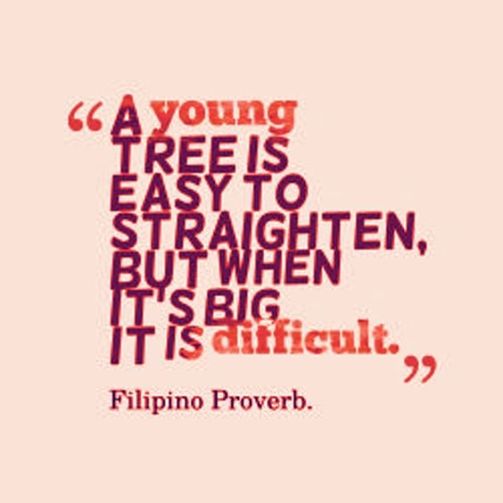
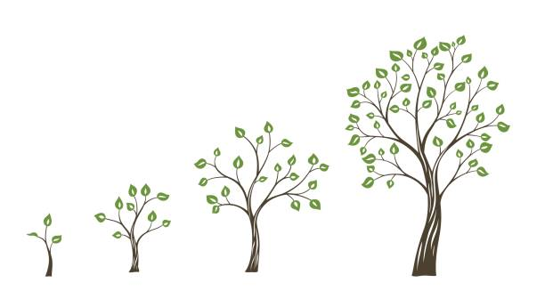

Slide 18
How to use Critical Thinking?

Slide 19
The Sponge and Panning for Gold Technique
The Sponge Technique
Absorbing Information
The Panning for Gold Technique
Filter the Information

Slide 20
Example Text:
“More often than not, when your teen disagrees with you, it may really be about having a different opinion in order to be different from you. When your teen was younger, chances are he thought you knew the answers to all his questions! Now he has the maturity and thinking skills to come up with some of the answers himself; maybe even incorrect answers. No matter what you disagree about, your teen needs to know he/she is loved; which is most often not communicated when everyone is upset.”
“Importantly, if parents have taught and demonstrated love and respect in the family when the children are younger, as a teenager, they will eventually learn to understand and accept the difference of opinions and respect their parents for being understanding and wise in how they dealt with them later on in their lives. I also know for sure that the more I desired my parents would change and prayed for it, the more I saw changes in myself first. Ten years later, my mother and I have a relationship that many say they are jealous of and wish they had with their own parents. I believe being humble enough to realize we don’t know-it-all, both parents and young people, goes a long way in God helping us love and respect each other.”

Slide 21
How to Use the Sponge and
Panning for Gold Approach?
Sound Conclusion
Ask Critical Questions
Actively Read/Listen
Uncover the best available idea/decision
To filter the informations obtained
To get as much information as possible

Slide 22
Guideline to Ask the Right Questions
What are the issues and the conclusions?
What are the reasons?
Which words or phrases are ambiguous?
What are the value conflicts and assumptions?
What are the descriptive assumptions?
What reasonable conclusions are possible?
Are there any fallacies in the reasoning?
How good is the evidence?
Are there rival causes?
Are the statistics deceptive?
What significant information is omitted?

Slide 23
Hold Assumptions Loosely
How to Ask
Better Questions
Open Ended Questions
Consider Counterintuitive
How to Ask the RIGHT Questions

Slide 24
Conclusion: What lesson we have learned from the project? What implications for further research

Slide 25
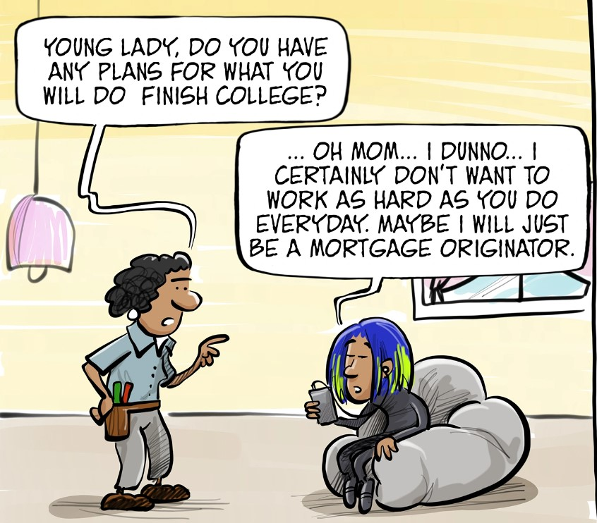
What lesson we have learned from our group project?
Separates the beliefs and behaviors belonging to members of two different generations.
Differences in thoughts, actions, and tastes exhibited by members of younger generations versus older ones.
Generation gap?
Does anyone even talk about it?
Is it even considered as an issue?

Slide 26
Does anyone even talk about it?
Step 3
Step 2
Step 1
Why can’t we respect each other’s emotions and feelings
Why do we people lack in understanding each other
Why do parents compare their childrens

Slide 27
Theories
Social Construction Theory
Social Cognitive Theory Venue
Social Identity Theory
Several theories have been identified that play a major role in this formation. Collectively the formation of these personalities, behaviors, and motives ultimately form each generation

Slide 28

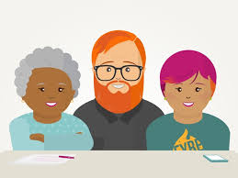
What implications for further research?
There are many things that make Millennials different from every other generation. From the onset each generation has been raised by people with vastly different life goals and different focus. During the overview of each generation, very little similarities were observed. The climate of the culture was vastly different from one generation to the next, which resulted in the values of each generation being different.

Slide 29
My Overview
Every minute was an adventure, or better yet, a remarkable meal with smart, lively, and engaging partners. And the insights we pulled from one another as co-authors were extraordinary.

